Slide 1



AI & ML
Intern
Final Review
Presented by Intern Team

Slide 2




Audisankara College
of Engineering & Technology
Submitted By:
Kumaresh Pundi (20G21A04I3)
Siddu Srinvas Puri (20G21A04I4)
Sharan Nallathuru (20G21A04F8)
Naveen Pallam (20G21A04H0)
GGuide : Mr. R. Rama Mohan., (M.Tech)
Associate Professor (Dept.of ECE)

Slide 3

Technotran
Company
TECHNOTRAN (Nellore) (ISO 9001:2015 Certified Company) is an Innovative Educational Technology Company in the fields of Embedded systems, Robotics,3d-printing, IoT & Artificial Intelligence. We serve universities, colleges, and schools nationwide. Our unwavering commitment revolves around delivering top-tier services, encompassing DIY Robotic kit design, electronic product design, PCB Design, prototyping, and Manufacturing, all meticulously customized to precise specifications. Our ultimate mission is to empower both students and institutions with state-of-the-art technology solutions.

Slide 4


agenda
1
5
Introduction
NumPy and Pandas.
2
6
Python Programming
Datasets
3
7
AI and ML
ML algorithms
4
8
Applications
K-Means

Slide 5
agenda
9
Project
10
project lifecycle
11
Code in Jupiter Notebook
12
Studying and Analysing the Datasets

Slide 6
Introduction
Internship
Technotran is a leading player in the AI landscape, harnessing the potential of artificial intelligence to redefine industry standards. Their expertise lies in developing AI-powered solutions that optimize processes, enhance decision-making, and unlock new possibilities. Through our internship, we've delved into the intricate workings of AI under their guidance, gaining invaluable experience in this rapidly evolving field.

Slide 7


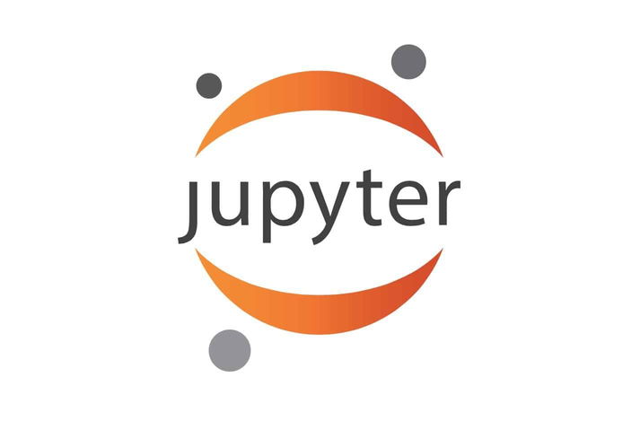

Python Programming
Python's simplicity, versatility, and vibrant community make it a powerhouse language across industries.
Python
Vs Code
Jupyter

Slide 8

AI & Ml
1
AI
2
ML
Machine learning, with its data-driven algorithms and predictive models, revolutionizes industries, enhancing decision-making, driving innovation, and unlocking new opportunities for growth and development, making it a cornerstone technology in the modern era. Its ability to extract insights from data empowers businesses to optimize processes
AI, with its data-driven insights and automation capabilities, reshapes industries, driving efficiency and innovation while presenting new opportunities for growth and development. Its ability to mimic human intelligence revolutionizes decision-making processes and unlocks transformative possibilities across various sectors.

Slide 9
applications of ai & ml
1
Ai
2
ml
1.Healthcare
2.Finance
3.Retail
4.Autonomous Vehicles
1.Healthcare
2.Finance
3.Marketing Advertisement
4.Productive Maintainance

Slide 10
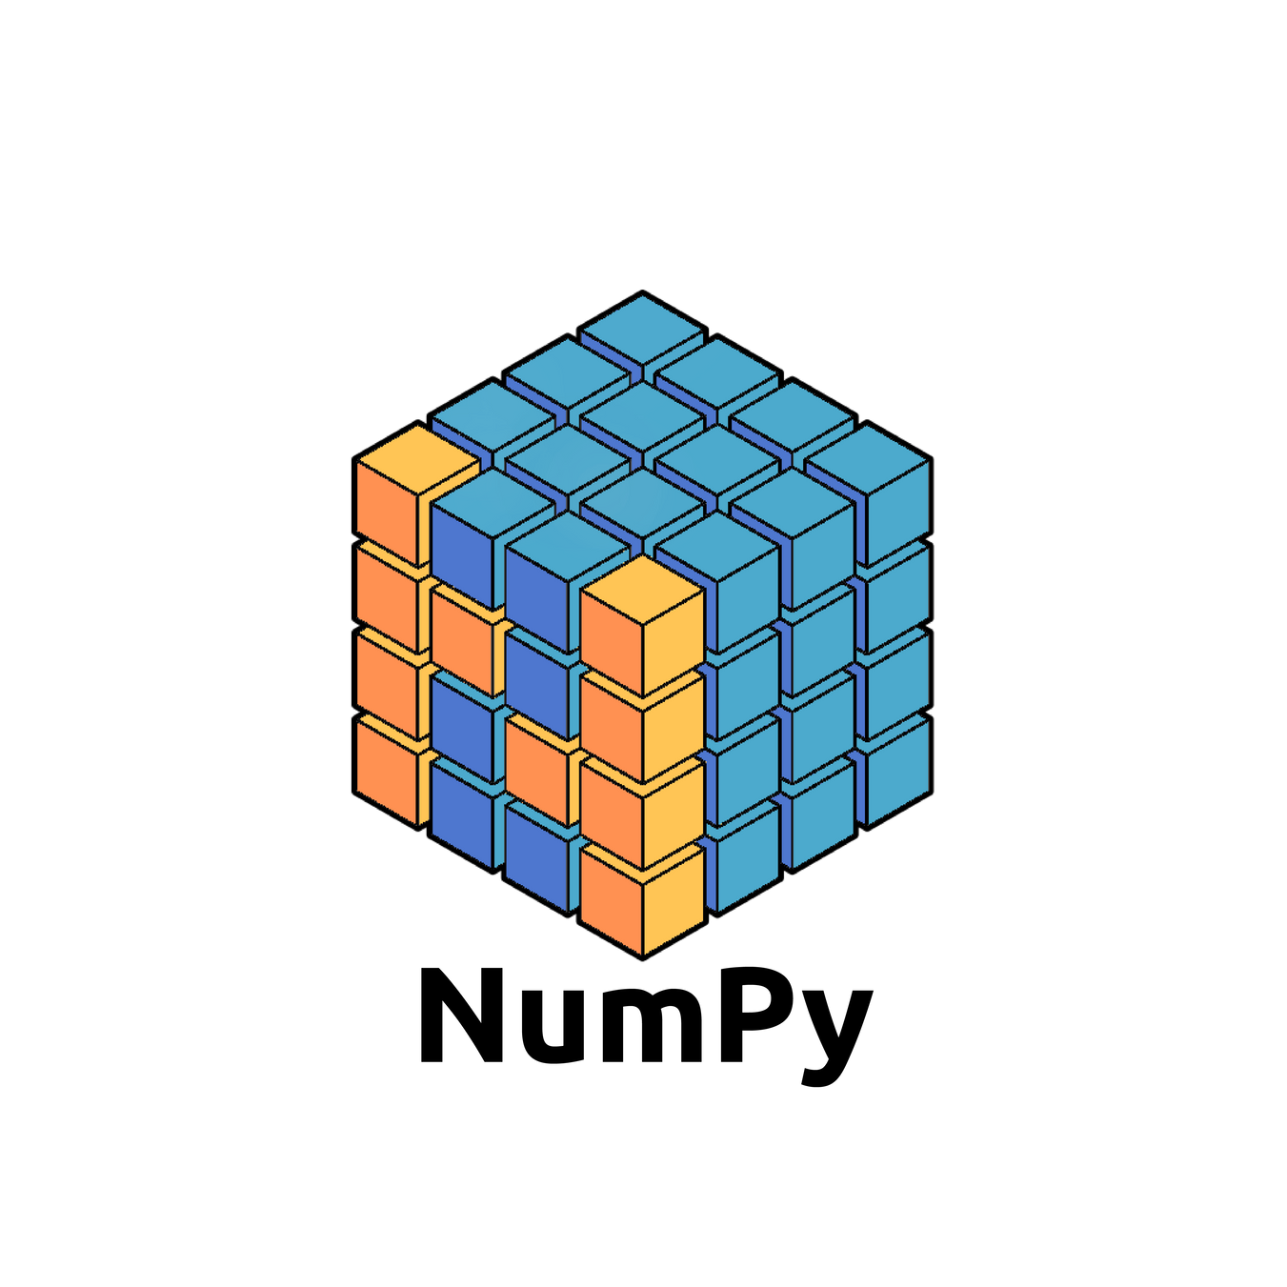
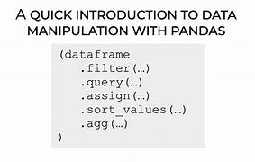
Numpy
Pandas
NumPy is a fundamental library in Python for numerical computing, providing powerful arrays and functions for mathematical operations.
Pandas is a versatile Python library for data manipulation and analysis, offering intuitive data structures and powerful tools for handling structured data effectively.

Slide 11
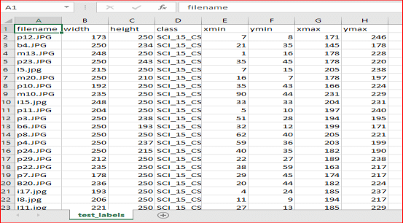
Datasets provide the raw material for training and testing machine learning models, serving as the backbone of algorithmic development and evaluation in various domains. Ensuring their quality and relevance is paramount for achieving accurate and reliable results in data-driven applications.
Datasets

Slide 12
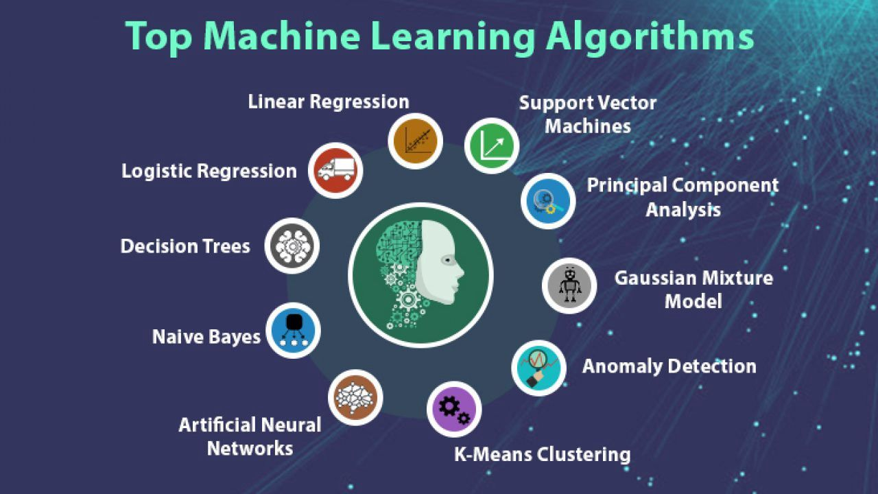
ML Algorithms
ML algorithms encompass a diverse range of computational techniques designed to learn patterns from data, enabling machines to make predictions, classifications, and decisions autonomously.

Slide 13
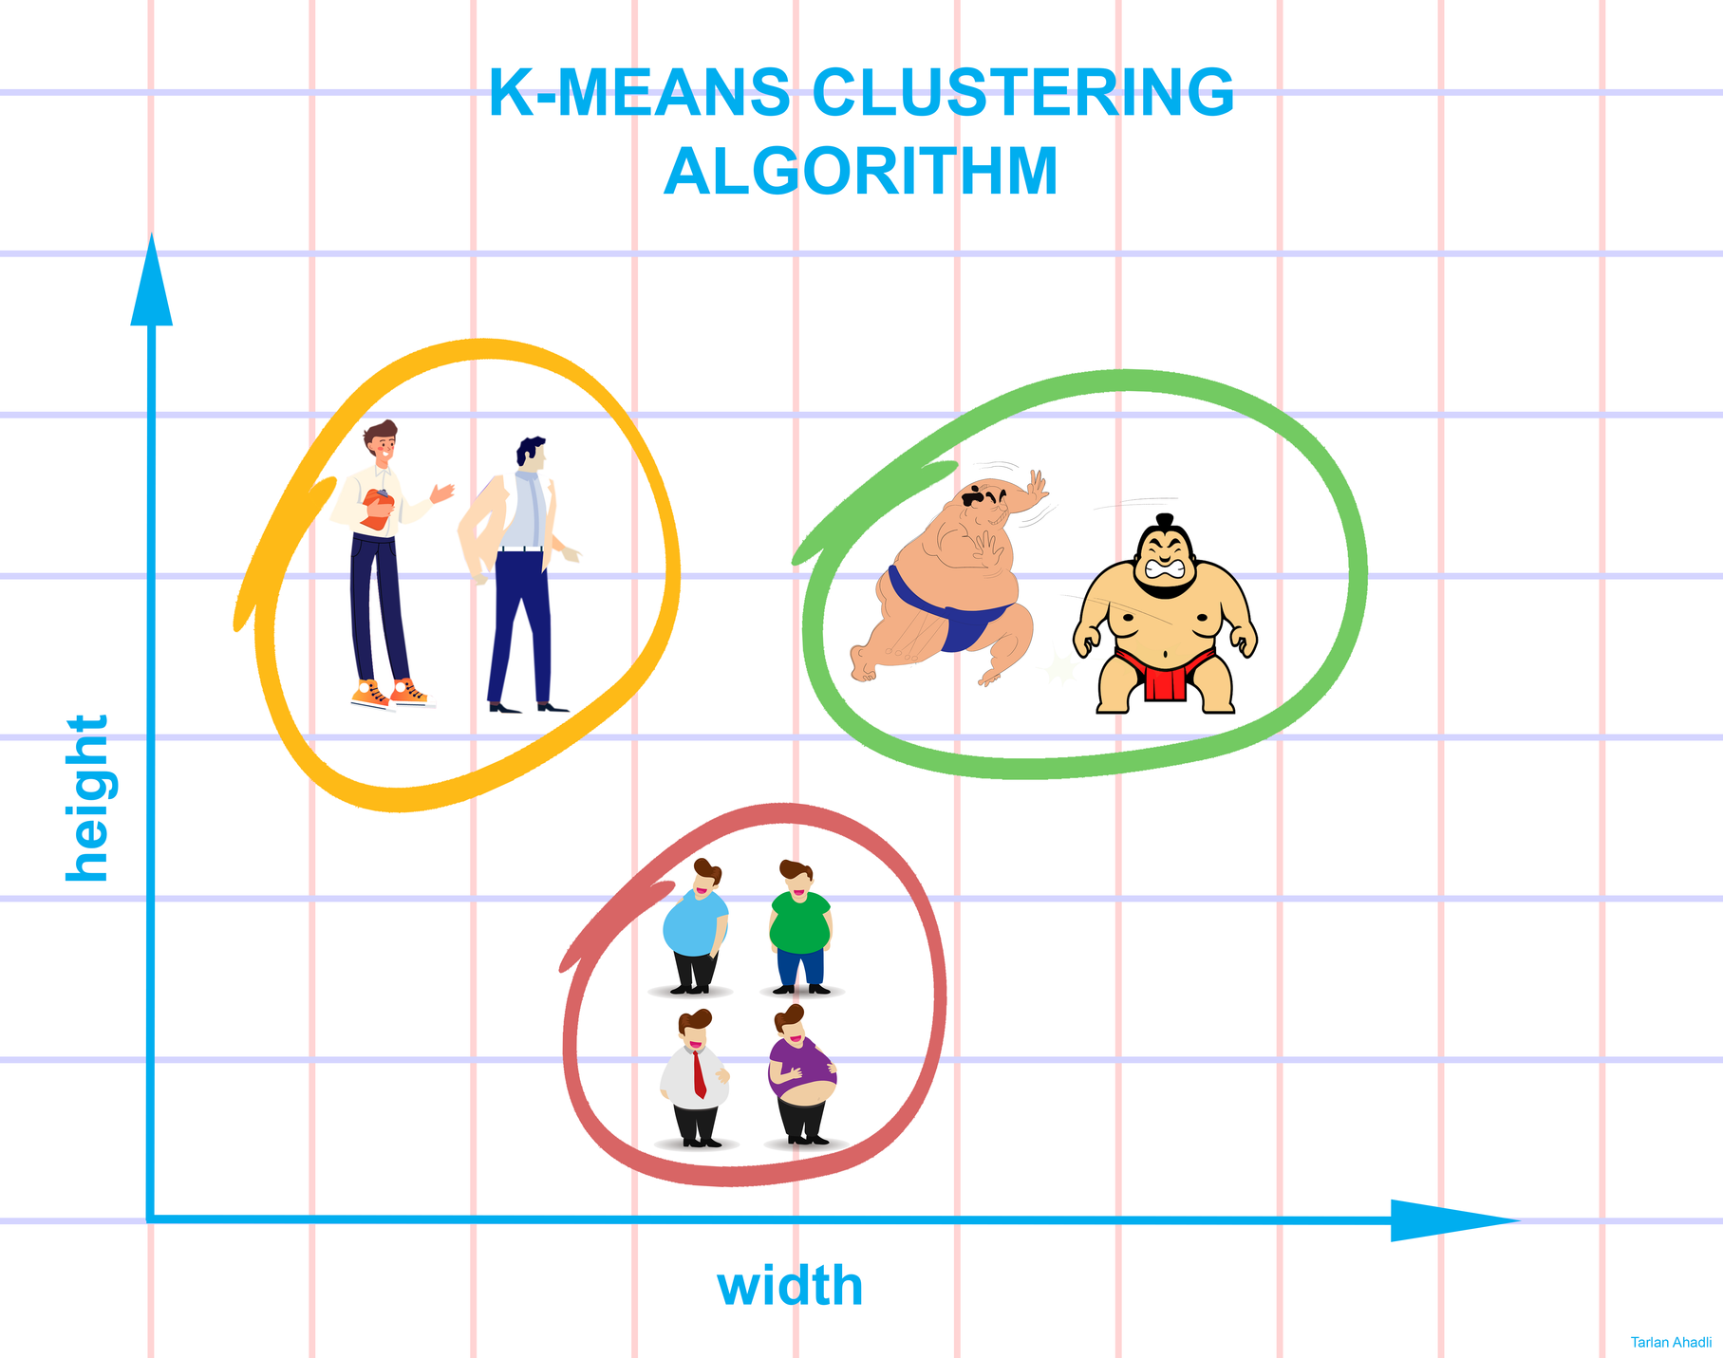
K - Means
AI & ML
K-means is a popular unsupervised machine learning algorithm used for clustering data points into distinct groups based on similarity, with the aim of minimizing intra-cluster variance and maximizing inter-cluster variance. It iteratively assigns data points to clusters represented by centroids, converging towards optimal cluster centroids through repeated refinement.

Slide 14
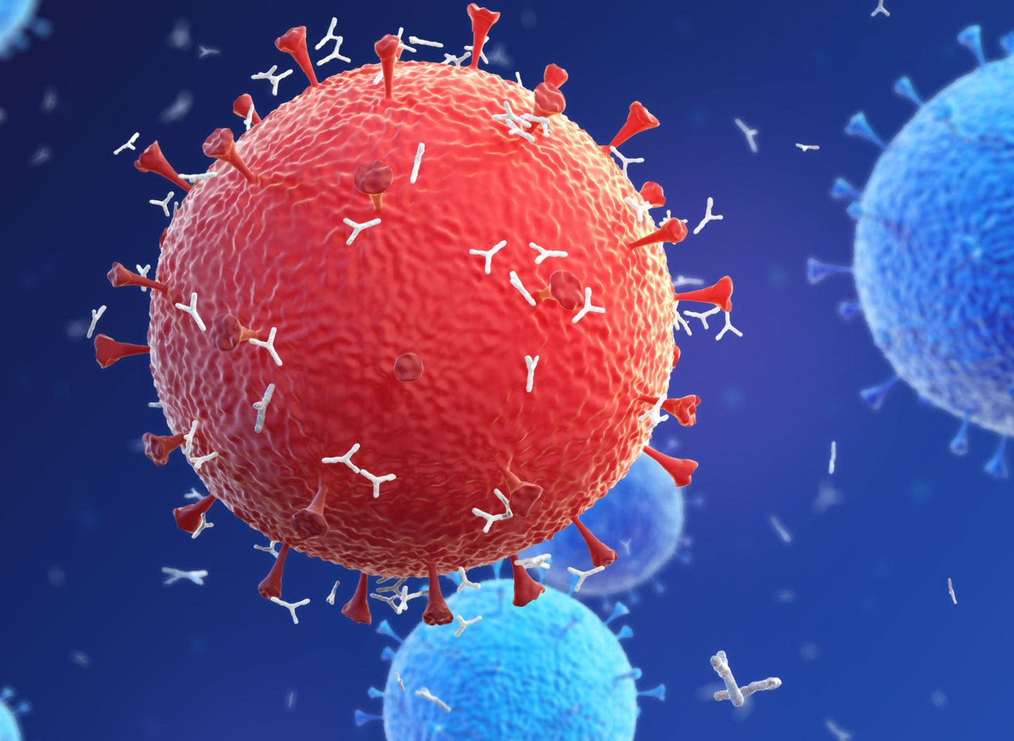
Corona-Virus Infection Probability using machine-learning
Project
Machine learning models can predict coronavirus infection probabilities based on factors such as demographics, symptoms, and exposure history, aiding in early detection and intervention efforts. By analyzing vast datasets, these models offer valuable insights to healthcare professionals for targeted screening and resource allocation.

Slide 15
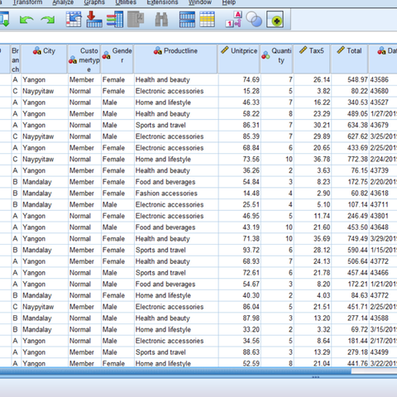
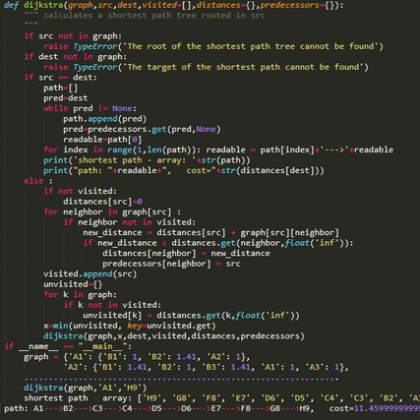
Project Life-Cycle
In this project, we employed a dataset comprising demographic details, symptoms, and exposure history. Utilizing Jupyter as our development platform, we constructed a machine learning model to estimate the likelihood of coronavirus infection, offering crucial insights for proactive detection and intervention measures.
Dataset
Python
Jupyter

Slide 16
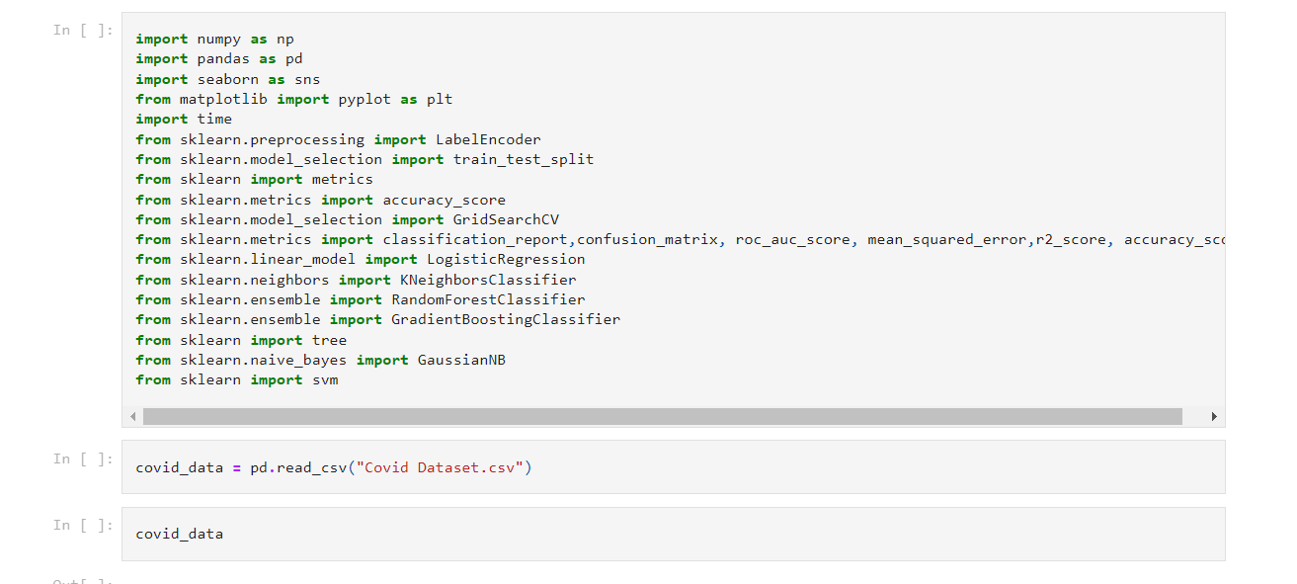
Code in Jupyter Notebook

Slide 17
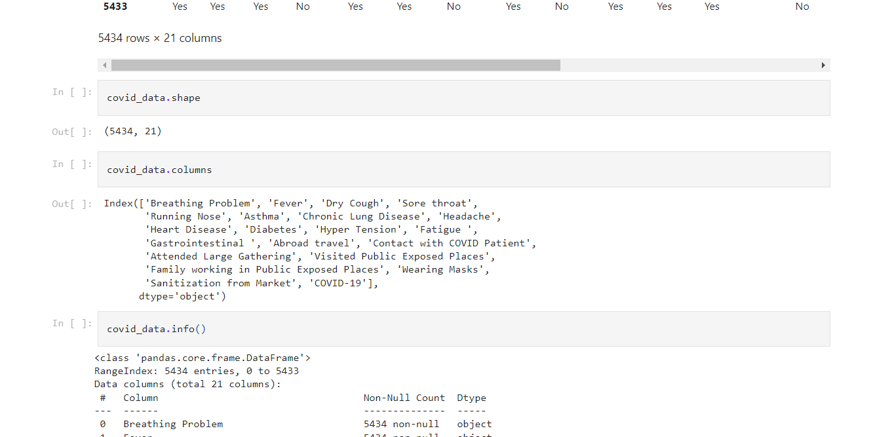

Slide 18
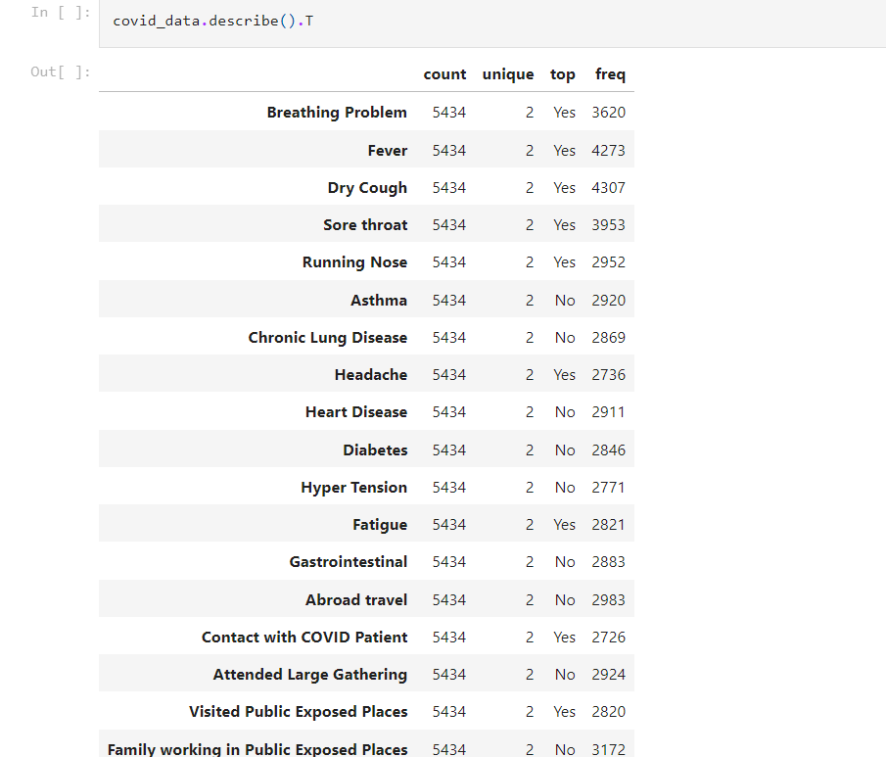

Slide 19
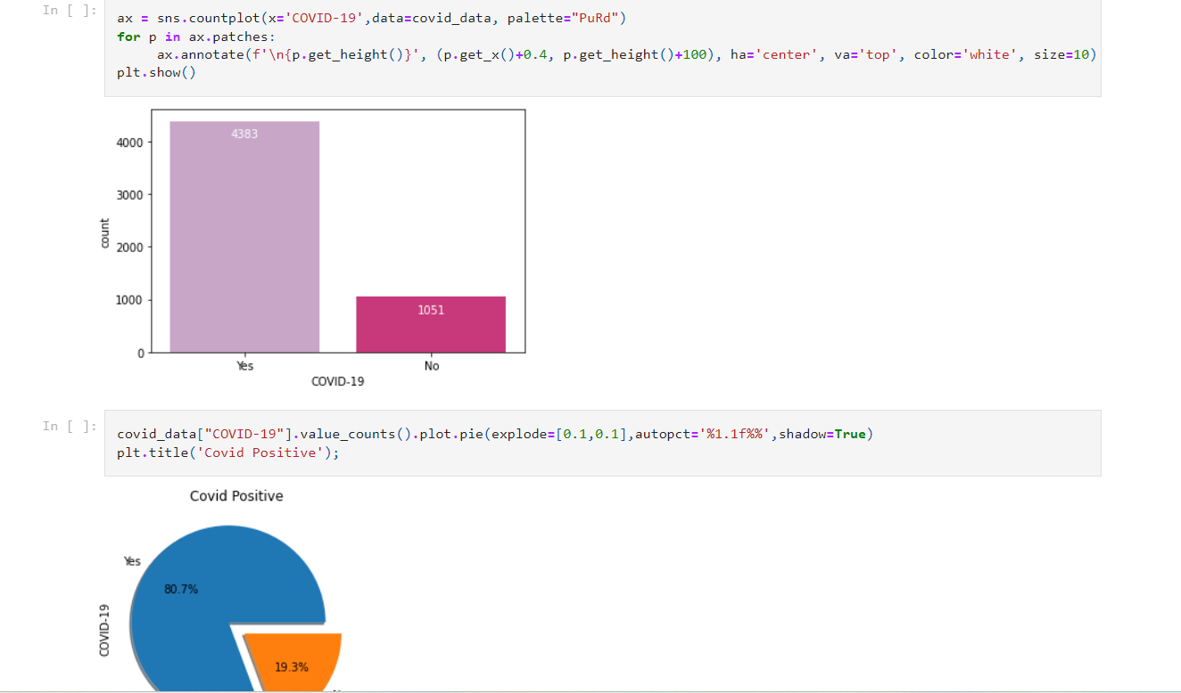

Slide 20
Studying and Analysing the Datasets
Output
The project involved thorough examination and analysis of the datasets, encompassing demographic information, symptoms, and exposure records. Through meticulous study and scrutiny, we extracted meaningful insights to inform the development of a robust machine learning model.

Slide 21
Thank
you!
@AI & ML Interns
Sigining Off

